Slide 1

BRITISH AIRWAYS
Build a predictive model to understand factors
that influence buying behaviour

Slide 2
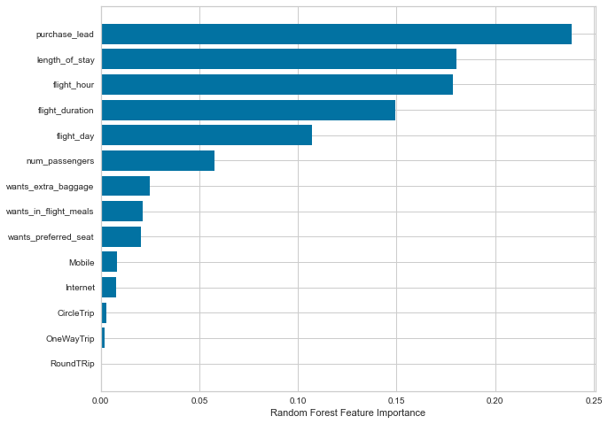
Summarized Findings:
Accuracy of the model predicting successful or incomplete booking is 0.62
Other Evaluation Metrics:
Precision: 0.62
(number of positive class predictions that actually belong to the positive class)
Recall: 0.58
(number of positive class predictions made out of all positive examples in the dataset)
F1 score: 0.6
(the harmonic mean of precision and recall and is a better measure than accuracy)
Top features that can drive successful flight bookings

